Slide 1


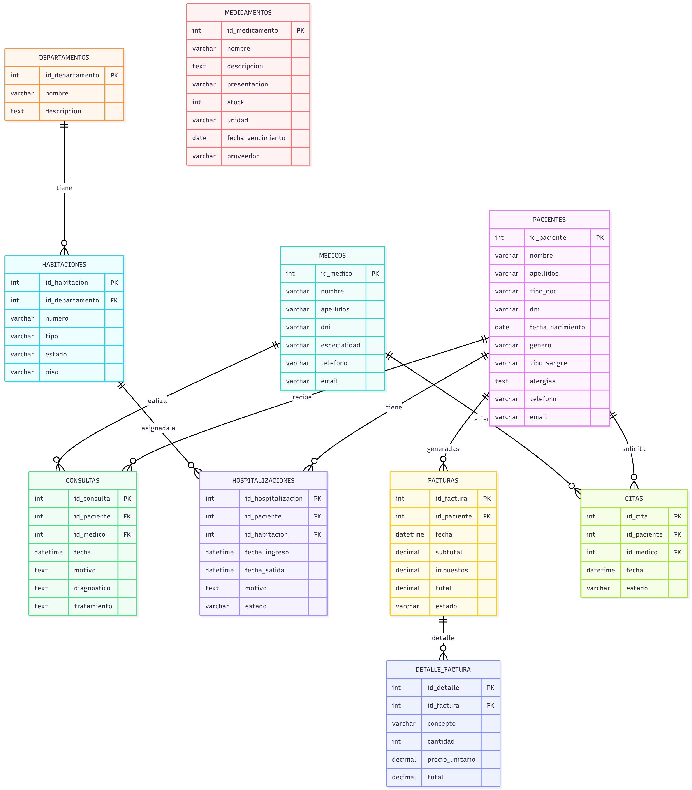



Hospital Management– Database Design & Implementation
Presented by:
José Alejandro Quintero Cárdenas
Manuel Alejandro Torrado Vergel

Slide 2
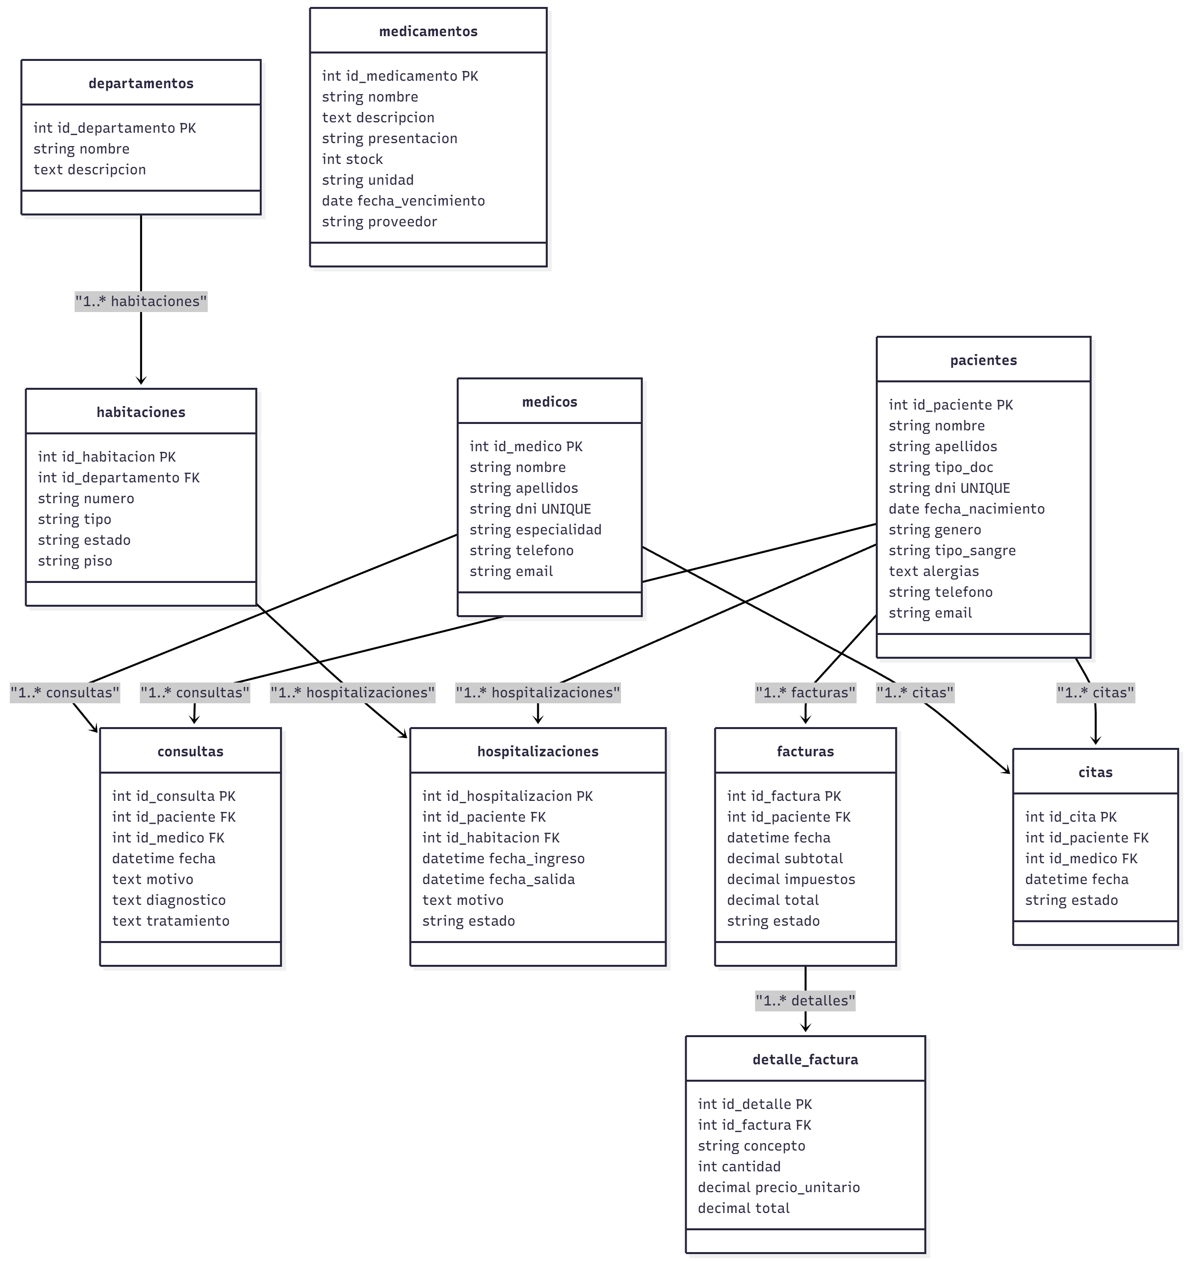
USE CASE DIAGRAM
2

Slide 3
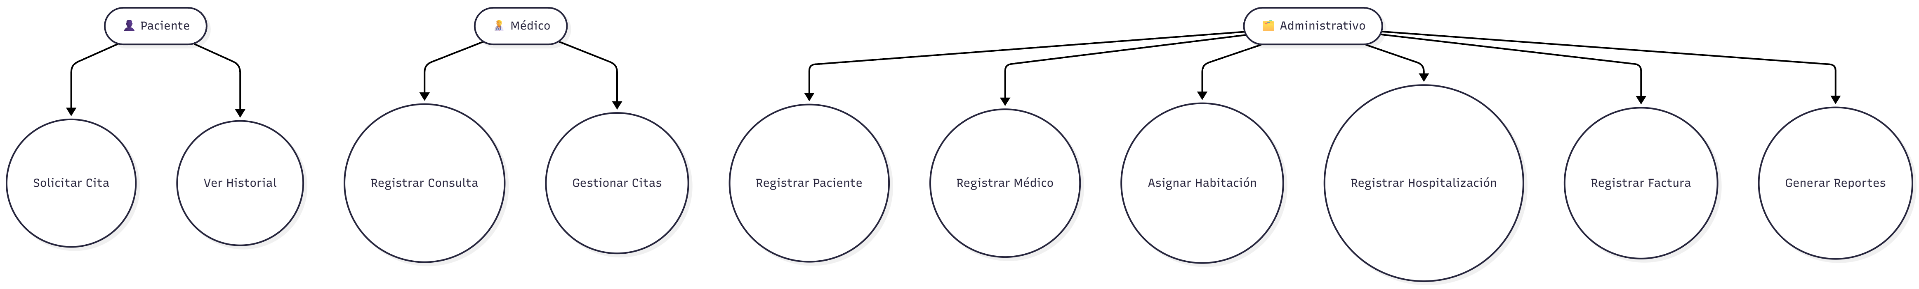
CLASS DIAGRAM
3

Slide 4
MAIN TABLES AND RULES
Main Tables
Patients: Stores all patient information.
Doctors: Contains doctor profiles and specialties.
Departments: Hospital department definitions.
Rooms: Room number, type, status, and floor.
Consultations: Diagnosis, treatment, doctor, patient.
Hospitalizations: Admissions, rooms, dates, status.
Invoices & Details: Billing and line items.
Medications: Stock, expiration, provider.
Appointments: Scheduled patient-doctor meetings.
Business Rules
Valid FK relationships must exist.
A room can host multiple hospitalizations.
Medication stock cannot be negative.
Invoices must match subtotal + taxes + details.
Appointments require valid doctor & patient.
Rooms must track availability status..
4

